Slide 1
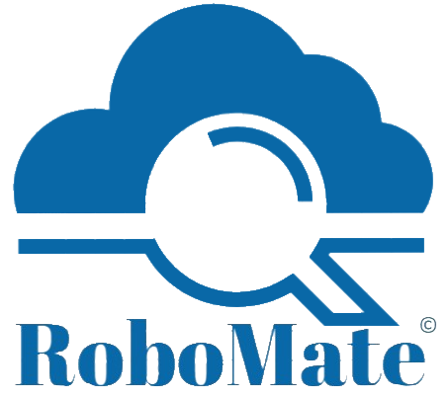
RoboMate Cloud Automation
Developed By : Marco Fekry

Slide 2
Agenda
What is RoboMate?
Cloud Providers support
RoboMate Cloud Automation – Assessments
RoboMate Cloud Automation - Automation Profile
Cloud Providers support Why are we using RoboMate?(Features)
RoboMate Cloud Automation – Reports

Slide 3
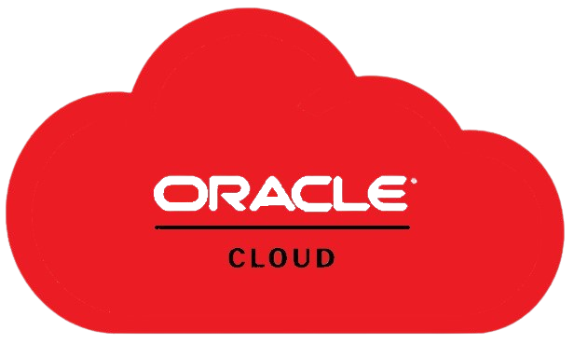
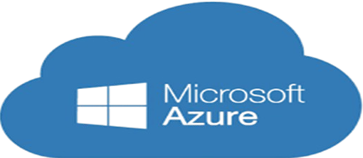
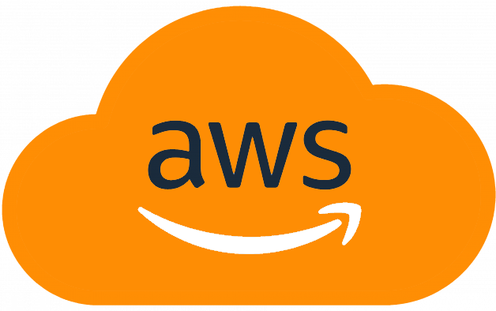
What is RoboMate?
RoboMate is a cloud automation desktop tool that integrates multiple code languages through a powerful UI, providing streamlined deployments to Azure, AWS, and OCI in just a few clicks. RoboMate is designed to assess cloud environments for Resources, Identity & Security, Cost Analysis, and Charts, ensuring optimal performance across the three cloud providers.
RoboMate offers customized deployment scenarios, providing a lot of deployment options using Azure Well Architected Framework, AWS Well-Architected Tool, OCI Security Best Practices, and the Microsoft Cybersecurity Reference Architecture.
Additionally, RoboMate automates reporting, assessment, and management across Azure, AWS, and OCI, ensuring seamless cloud operations with consistent configurations and best practices.

Slide 4

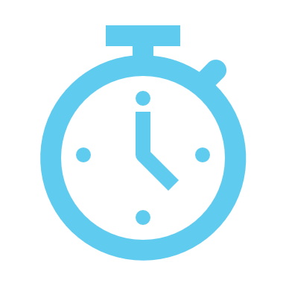




Why are we using RoboMate? (Features)
RoboMate allows us to manage production environments in just a few clicks
RoboMate minimizes administrative efforts, converting hours of hard work into minutes.
RoboMate minimizes administrative efforts
RoboMate streamlines deploying resources, eliminating human errors and improving efficiency
RoboMate automations are interactive, making it easy for the user to select their requirements.
RoboMate deployments are captured from real production customer environments, providing reliable use cases.

Slide 5

Integrated Cloud Operations and Optimization
Compute: Manages automated deployment, scaling, and monitoring of compute resources across cloud environments (Azure, AWS, OCI).
Security: Provides automated security assessments and compliance checks based on best practices, ensuring secure and compliant deployments.
Identity: Streamlines identity management tasks, ensuring proper role-based access and monitoring.
Cost Analysis: Delivers automated insights into cost management and optimization across multi-cloud setups.

Slide 6
Cloud Providers Support
Assessment: RoboMate performs in-depth assessments across Azure, AWS, and OCI environments, including resources, security, identity, and cost analysis.
Reporting: Generates comprehensive reports for security, compliance, and performance metrics, providing valuable insights into each cloud environment's status.
Automation: Automates tasks such as resource deployment, updates, migrations, and deletions across Azure, AWS, and OCI, ensuring consistency and efficiency in multi-cloud management.

Slide 7
Reporting Options RoboMate offers a wide range of reporting capabilities across Azure, AWS and OCI to help users effectively monitor their cloud environments. Here are some key reporting options
Resources Report: Provides an overview of all deployed resources.
Business Continuity Report: Highlights strategies for maintaining business operations.
Cost Optimization Report: Analyzes cloud expenses and provides recommendations for cost savings
Security Reports: Includes Initial Security Report and Advanced Security Report to evaluate AWS security configurations
Performance Optimization: Robo Mate ensures cloud workloads operate at peak efficiency by monitoring resource utilization and identifying bottlenecks

Slide 8

RoboMate Cloud Automation - Assessments
RoboMate Cloud Automation is an AI-driven assessment and automation tool designed to enhance cloud productivity. Key assessment features include:
Resource Assessment: Offers comprehensive insights into resource usage and cloud costs for better management.
Charts Analysis: Provides in-depth chart analysis to track performance trends and continuous improvement.
Cost Optimization: Delivers actionable recommendations to optimize resource allocation and reduce unnecessary expenses.
RoboMate supports major platforms like Microsoft Azure, AWS, OCI, focusing on reliability, security, cost, and performance.
can watch the following demonstration videos Azure ,AWS, OCI

Slide 9
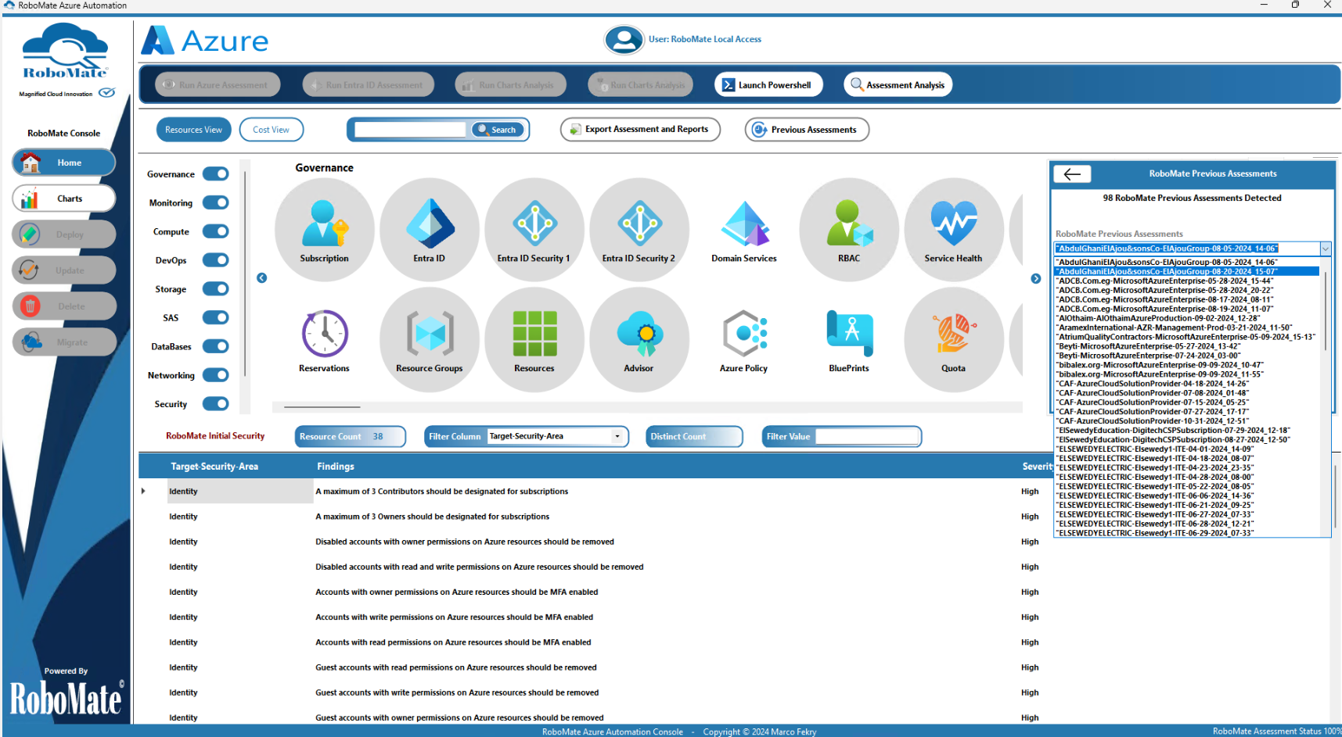
RoboMate Cloud Automation Assessments
Your previous assessments are readily accessible and can be reviewed at any time, as needed

Slide 10
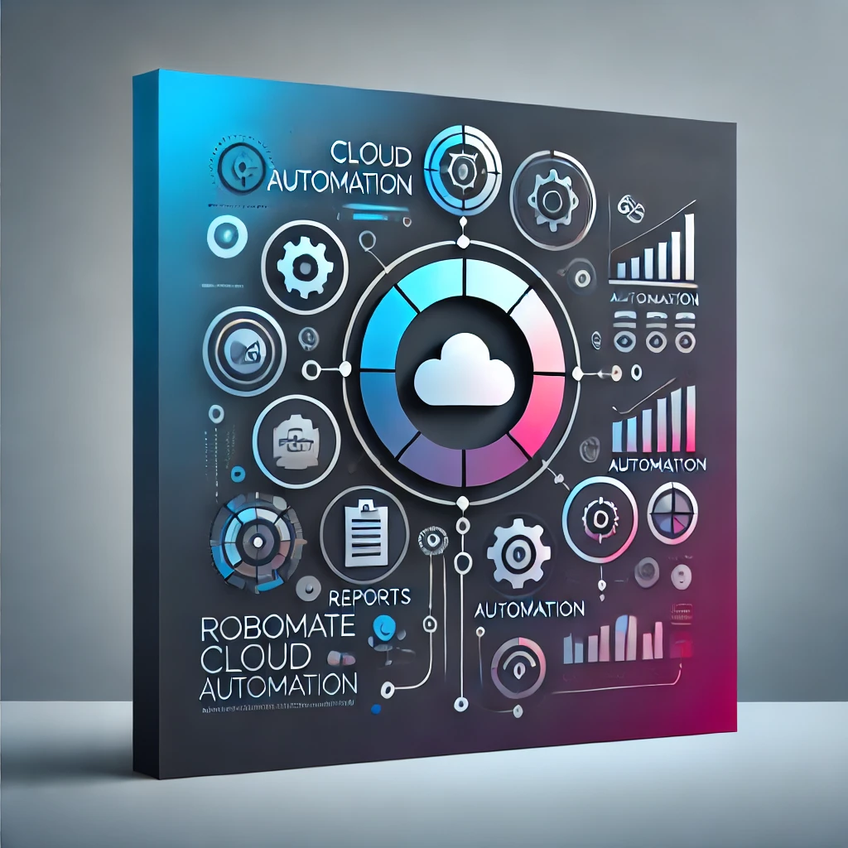
RoboMate Cloud Automation - Reports
RoboMate Cloud Automation provides a comprehensive range of reports in its assessments, helping you gain visibility across all cloud environments.
Report types include:
- Resources Inventory.
- Cost Optimization.
- Business Continuity.
- Cloud Native Security.
- Security Compliance.
These assessments are available across all cloud environments.
You can watch the following demonstration videos Azure ,AWS, OCI

Slide 11
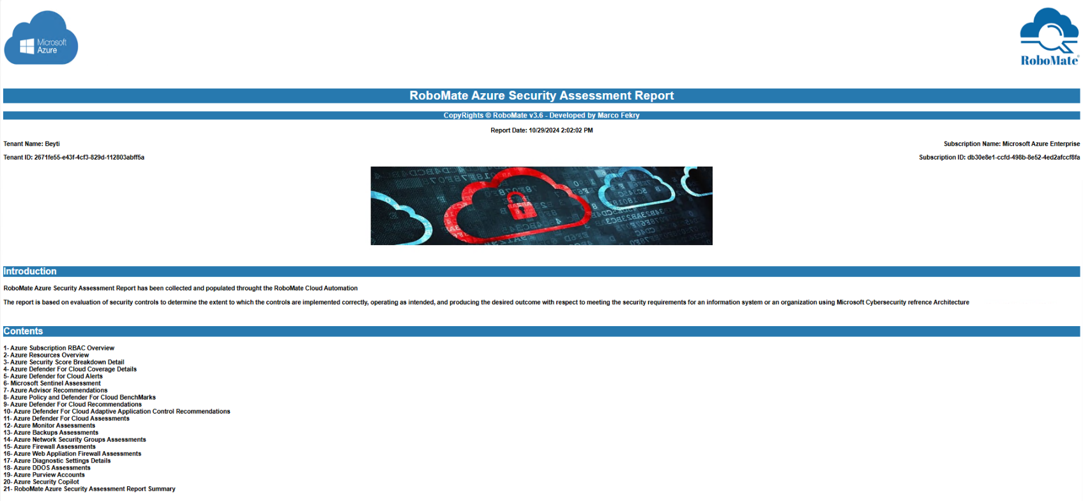
RoboMate Azure Security Assessment Report
An example shows RoboMate Security Assessment
For Azure

Slide 12

RoboMate Cloud Automation - Automation Profile
Use RoboMate Cloud Automation for Azure, AWS, or OCI to deploy a wide range of automation profiles, including:
- Complex Workloads Automation Deployments.
- Landing Zones and Full Environmental Architecture Deployments.
- Monitoring and Audit Deployments.
- Resource Migration Across the Same Cloud Providers.
- Security Hardening Deployment Plan Using Cloud-Native Security Frameworks.
can watch the following demonstration videos Azure ,AWS, OCI

Slide 13

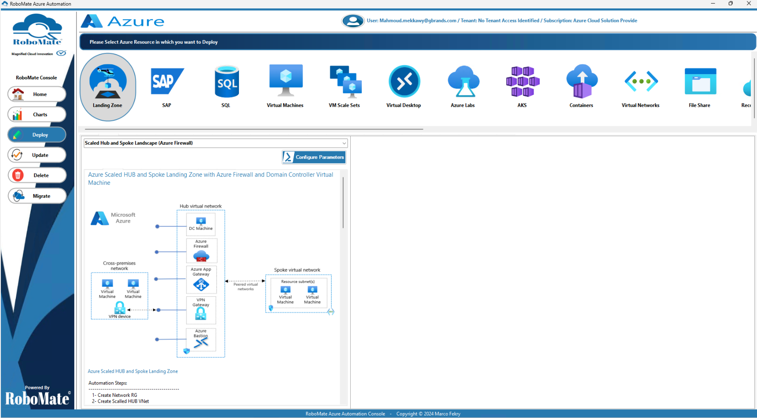
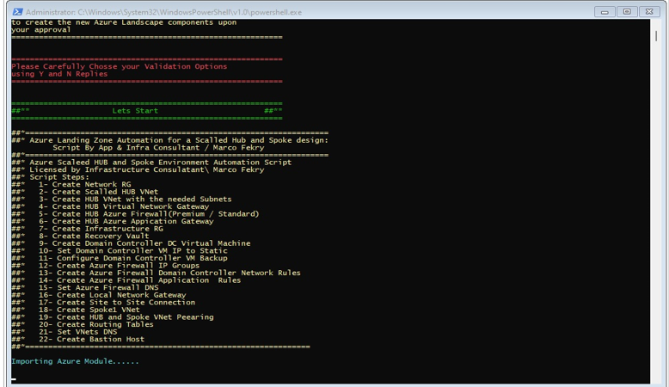
Examples of "Create Your Deployment" Using RoboMate
This screenshot shows how RoboMate is used to create and manage deployments efficiently.

Slide 14
Thank You
RoboMate Cloud Automation

